Slide 1


School of Computer Science & IT Department of BCA
INTRODUCTION TO LINUX(20BCA1C06)
MODULE 2: The UNIX File System
Faculty : Dr. Ananta Ojha

Slide 2
Session -4
Allocation of Disk Blocks
Other File Types in UNIX

Slide 3
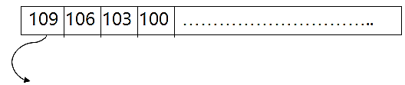
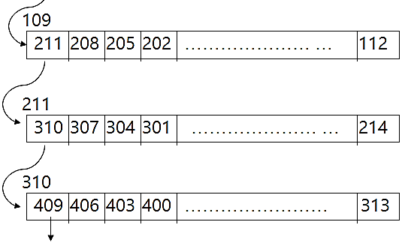
Allocation of Disk Blocks
When a process writes data to a file, the kernel must allocate disk blocks from the file system for direct data blocks and indirect blocks as needed.
The file system super block contains an array that keeps track of the numbers of free disk blocks in the file system. The last block in the super block points to a block that contains a list of free blocks.
When a file system is created (using mkfs command), the data blocks are organized in a linked list, such that each link of the list is a disk block that contains an array of free disk block numbers, and one array entry is the number of the next block of the linked list.
Super Block Array
Linked list of free disk block number

Slide 4
Major Steps:
When the kernel wants to allocate a block from a file system, it allocates the next available block in the super block array. Once allocated, the block cannot be reallocated until it becomes free.
If the allocated block is the last available block in the super block array, the kernel treats it as a pointer to a block that contains a list of free blocks.
In such case, it reads the block, populates the super block array with the new list of block numbers, and then proceeds to allocate these block numbers one by one.
It allocates a buffer for the available free block and clears the buffer's data. (Now, a disk block is allocated and the kernel has a buffer ready to write the data to the disk.)
If the file system contains no free blocks, the calling process receives an error.
If a process writes a lot of data to a file, it repeatedly asks the kernel for blocks to store the data, but the kernel assigns only one block at a time.

Slide 5
Algorithm: alloc input: file system number output: buffer for new block
{
while (super block locked)
sleep (event: super block not locked);
remove block from super block free list;
if (removed last block from free list) {
lock super block;
read block just taken from free list;
copy block numbers in block into super block;
unlock super block;
wakeup (event: super block not locked);
}
get buffer for block removed from super block list;
clear buffer contents;
decrement total count of free blocks;
mark super block modified;
return buffer;
}

Slide 6
Other File Types
The UNIX system supports two other file types: pipes and special/device files.
A pipe, sometimes called a fifo (for "first-in-first-out"), differs from a regular file in that its data is transient: Once data is read from a pipe, it cannot be read again.
Also, the data is read in the order that it was written to the pipe, and the system allows no deviation from that order.
The kernel stores data in a pipe the same way it stores data in an ordinary file, except that it uses only the direct blocks, not the indirect blocks.
The special files include: block device special files and character device special files.
Both types specify devices, and therefore the file inodes do not reference any data.
Instead, the inode contains two numbers known as the major and minor device numbers.
The major number indicates a device type such as terminal or disk, and the minor number indicates the unit number of the device.

Slide 7

THANK YOU Any questions…?

